Slide 1
UI/UX – Design Principles
Mood Board + Design Critique
Frontend & UI/UX Internship Task

Slide 2
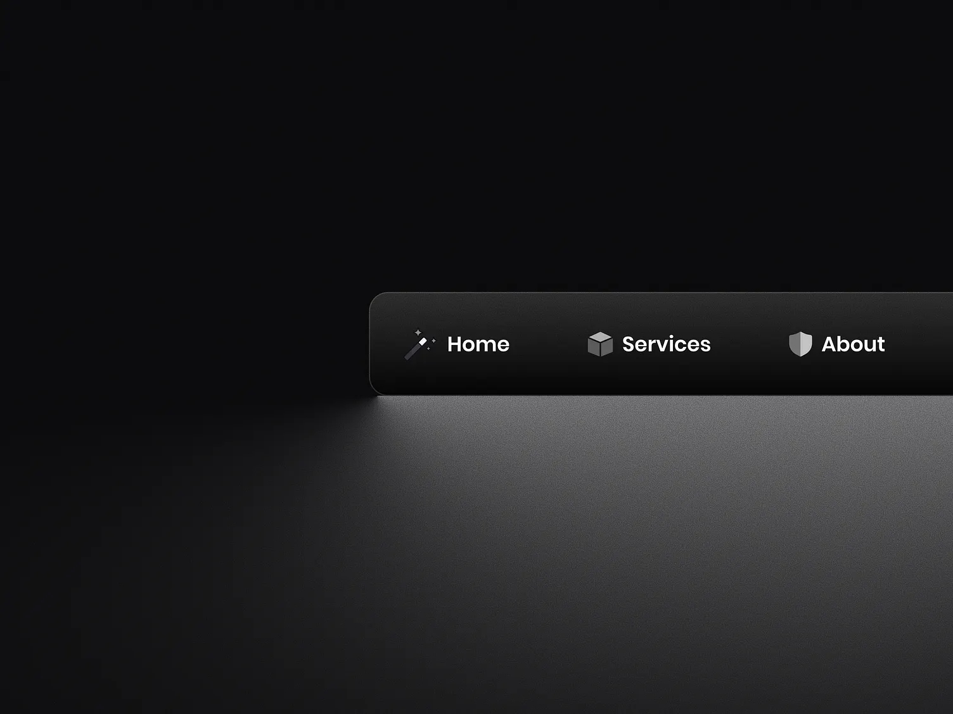
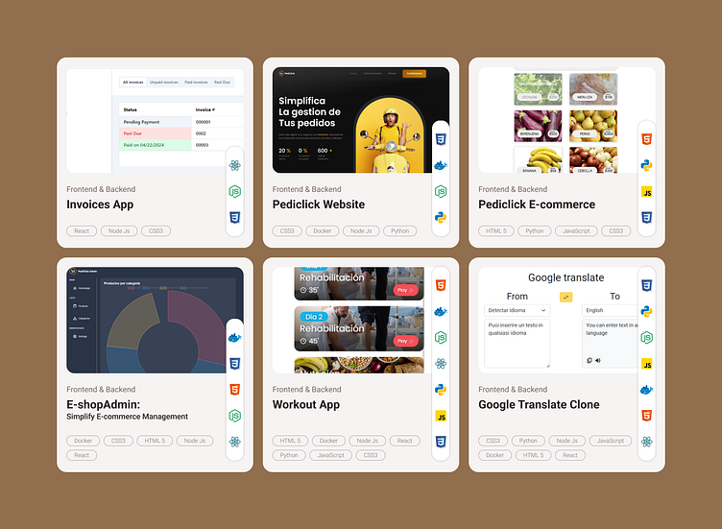
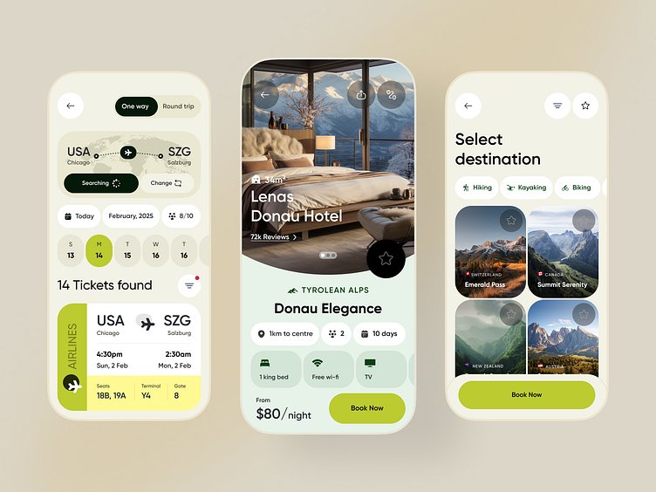
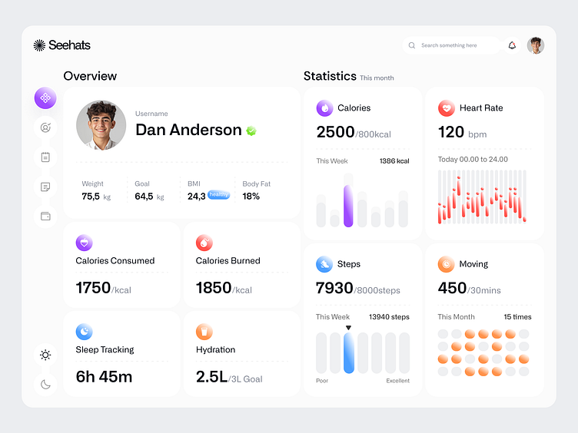
Task – 1 Mood Board

Slide 3
Task 2 - Design Critique (YouTube)
Good UI Points:
Clean and simple navigation bar.
Easy video search functionality. Proper spacing between content cards.
Dark mode improves user experience
Bad UI Points:
The homepage feels crowded with recommendations.
Too many ads can distract users
Suggested Improvements:
Reduce ad clutter for a cleaner experience.
Improve category organization.
Add more customization options

Slide 4
Conclusion
This task helped in understanding the importance of UI/UX principles.

